Slide 1
E - Commerce Purchase Data Analysis
M. Tech. – DSML → Team 7
Date: 24th Oct 2020
NPV – Project Presentation
PRAVEEN MANOHAR G
RAHUL A
RAJESH RAMACHANDER
RANJITH GNANA SUTHAKAR ALPHONSE RAJ

Slide 2
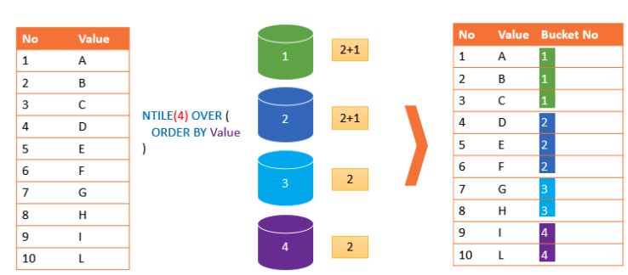
NTILE() – Overview and Logic
NTILE() function is used to divide data into Tiles(Groups) and returns the number of the tile to which the row belongs.
Part of the family ranking functions.
Format: NTILE(n) OVER (PARTITION BY <expression>[{,<expression>...}]
ORDER BY <expression> [ASC|DESC], [{,<expression>...}] )

Slide 3
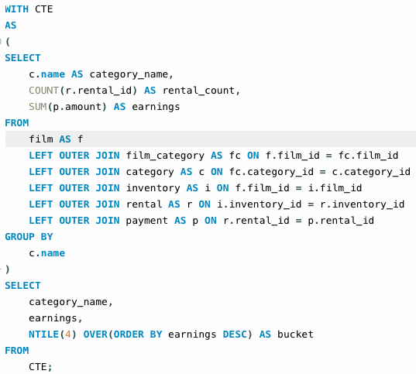
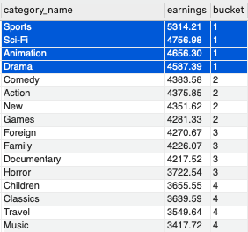
Classify the film genres into buckets based on top earnings ?

Slide 4
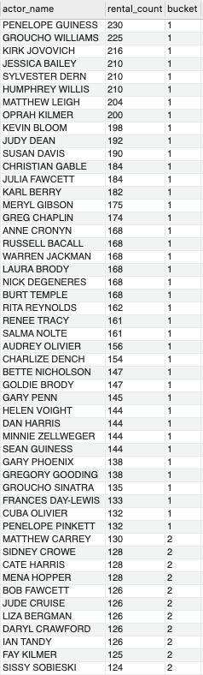
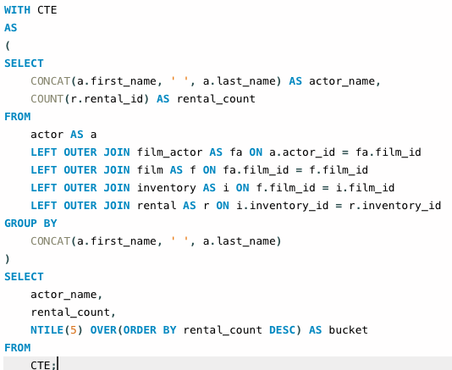
Classify actors into buckets of most rented (demand)?

Slide 5
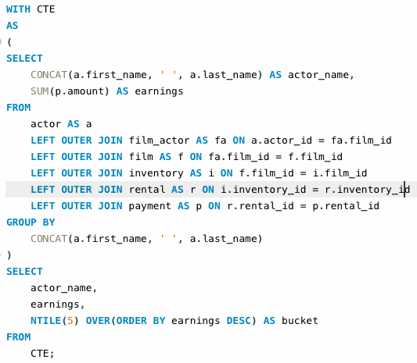
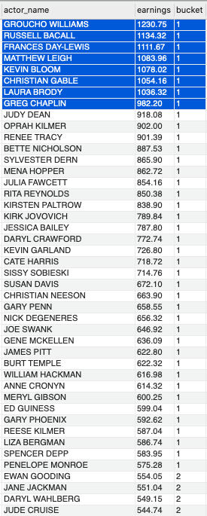
Which actors are most promising to invest based on current earnings?

Slide 6
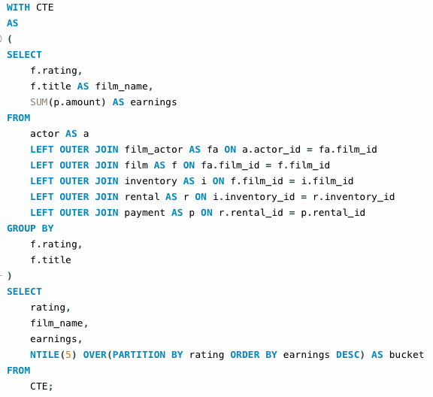
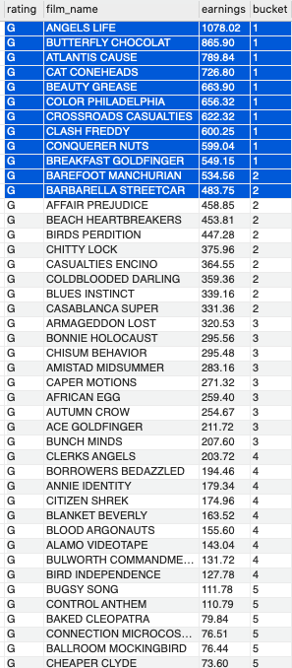
Bucket list of movies based on ratings and best earnings?

Slide 7
Thank You!
Project Team
PRAVEEN MANOHAR G
RAHUL A
RAJESH RAMACHANDER
RANJITH GNANA SUTHAKAR ALPHONSE RAJ

